Slide 1

RV College of Engineering
RFID Enabled Locker with Blockchain Technology
Sudhanvar B P
Likith K S Aditya Ranjan Samkit Samsukha
1RV23ET051
1RV23ET021
1RV23AI008
1RV23IS105
R.V. College of Engineering, Bengaluru

Slide 2
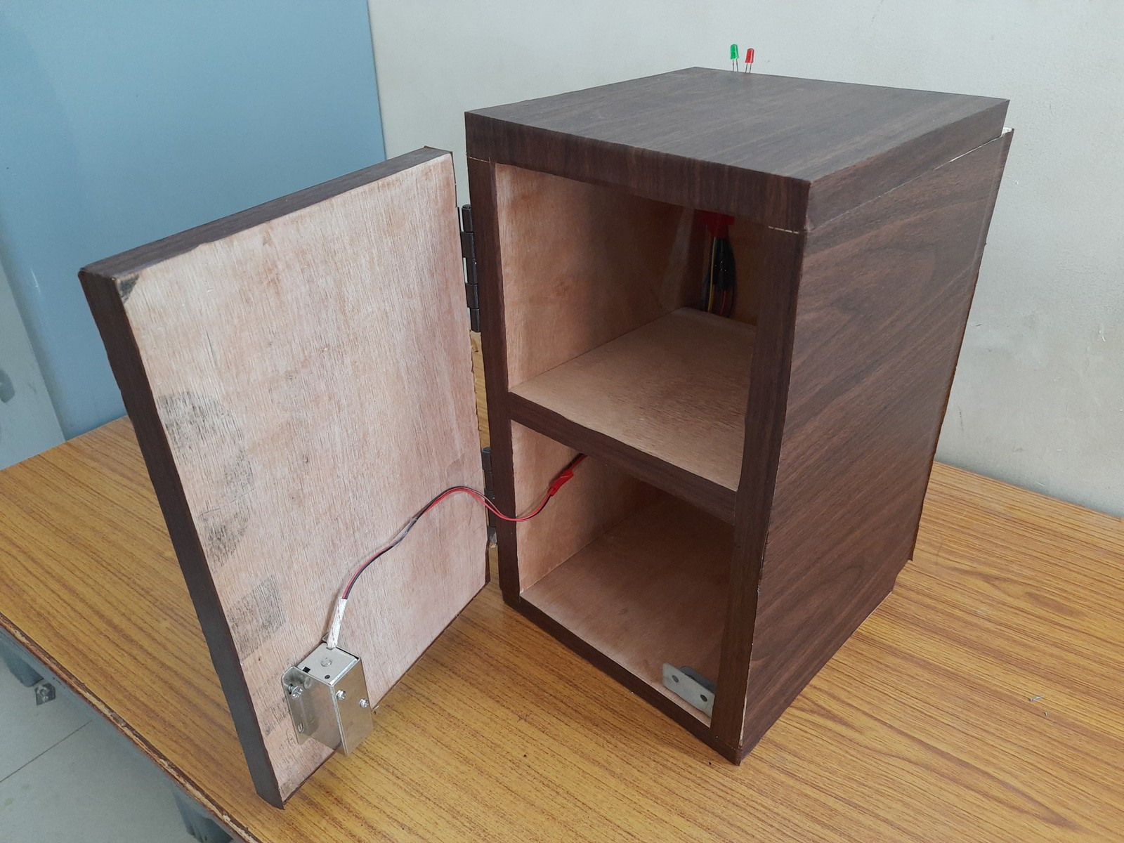
Introduction
Go, change the world
RV College of Engineering
We have created a RFID based Secure Cupboard. Our project integrates multiple technologies like Arduino Interfacing, Web Development and Blockchain design. These technologies, all combined, have helped us come up with our secure locker which is ready to be sold via an e-commerce application and it’s proposed that we will offer dual storage using a Block chain network to all the customers.

Slide 3
Objectives
Go, change the world
RV College of Engineering
The objectives behind making the secure locker was -
Understand how RFID works and how it’s used in real life, like tracking and access control.
Design a secure storage system using RFID and Arduino to ensure only authorized access.
Develop a web app to market and sell your product, ensuring it can handle growing user numbers.
Learn about blockchain and design a plan to use it for secure and reliable storage.

Slide 4
Literature Survey
Go, change the world
RV College of Engineering
Year | Author | Title | Approach | Result
2012 | Preet Kaur; Davinder Parkash Chechi | The RFID Technology and Its Applications : A Review | Brief Introduction to principles of RFID, classification of RFID tags and reader, frequencies used. | Overview of current state and trends of RFID technology that will open new doors to make organizations, companies more secure, reliable, and accurate
2021 | Akhilesh A. Waoo; Shubham Soni | RFID-Based Digital Door Locking System | IoT-enabled RFID-based door locking gadget that will know how long the door is open and only those people who register will be able to enter using their card. It uses a servo motor that operates with the help of Arduino. It is also very secure. | It is an IoT-based gadget designed for RFID- based door locking systems, developed with the help of Arduino. This gadget is being managed by software programming.
2018 | A. Lanko1 ; N. Vatin1 ; A. Kaklauskas | Application of RFID combined with blockchain technology in logistics of construction materials | The main advantages, shortcomings, perspectives, as well as difficulties arising in the implementation of blockchain technology in the construction industry are described. | The combination of RFID and blockchain technologies will significantly reduce losses from the influence of the human factor and intentionally false information, eliminate the problem of trust between the participants in the turnover.

Slide 5






RV College of Engineering
Go, change the world
Technologies that we have used

Slide 6
Methodology
Go, change the world
RV College of Engineering
Project Details
Our project features an e-commerce website offering a variety of innovative products for purchase. Built using NextJS and TailwindCSS, a key highlight is our RFID-controlled cupboard powered by Arduino, providing secure and automated storage solutions. This system includes an RFID-RC522 module, LEDs for visual feedback, a piezo buzzer for audible alerts, a pushbutton for manual reset, a solenoid controlled via a relay module, and a DC adapter for power. Additionally, we offer a blockchain wallet for users to securely store their files, combining convenience with cutting-edge technology. Our integrated approach ensures a seamless and secure user experience.

Slide 7
Methodology
Go, change the world
RV College of Engineering
Wiring Details
Arduino UNO
D13 connected to the anode of the green LED
GND connected to the cathodes of the green and red LEDs, pushbutton, piezo buzzer, RFID-RC522, and the GND of the relay module
Reset connected to one terminal of the pushbutton D12 connected to one terminal of the piezo buzzer D11 connected to the anode of the red LED
Vin connected to the positive terminal of the 12V battery
3.3V connected to the 3.3V of the RFID-RC522
D9 to D5 connected to IRQ, MISO, MOSI, SCK, and SDA of the RFID- RC522 respectively
D10 connected to the IN pin of the relay module
Solenoid
Pin1 connected to COM of the relay module
Pin2 connected to N.O. of the relay module
1 Channel 5V Relay Module
VCC+ connected to the positive terminal of the 12V battery VCC- (GND) connected to Arduino UNO GND
IN connected to Arduino UNO D10
COM connected to one terminal of the solenoid
N.O. connected to the other terminal of the solenoid
12V Battery (mini)
+ connected to VCC+ of the relay module and Arduino UNO Vin
- connected to VCC- (GND) of the relay module and Arduino UNO GND
RFID-RC522
SDA, SCK, MOSI, MISO, IRQ connected to corresponding pins on the Arduino UNO GND connected to Arduino UNO GND RST connected to Arduino UNO Reset via pushbutton
3.3V connected to Arduino UNO 3.3V
LED: Two Pin (green)
Anode connected to Arduino UNO D13 Cathode connected to Arduino UNO GND LED: Two Pin (red)
Anode connected to Arduino UNO D11 Cathode connected to Arduino UNO GND
Piezo Buzzer
Pin 1 connected to Arduino UNO D12 Pin 2 connected to Arduino UNO GND Pushbutton
Pin 1 connected to Arduino UNO Reset Pin 2 connected to Arduino UNO GND

Slide 8
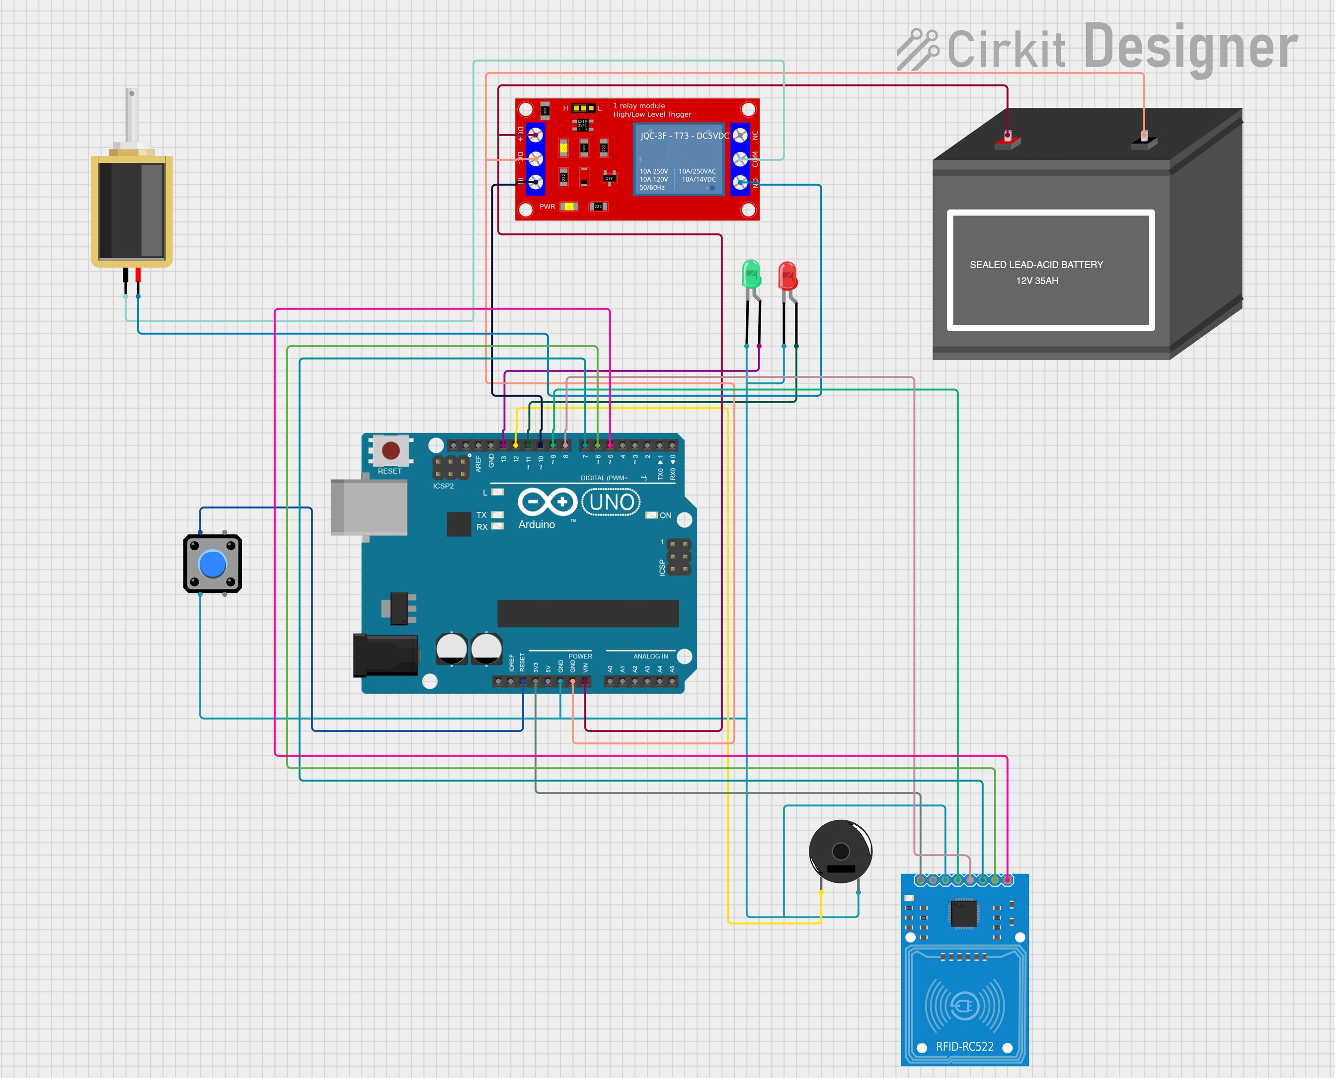
Methodology
Go, change the world
RV College of Engineering
Circuit Diagram
Cost of making:
Electronic components:680/ Cupboard making:400/-
Total: 1080/-

Slide 9
Methodology
Go, change the world
RV College of Engineering
Component
Remarks
Arduino UNO
Microcontroller board based on the ATmega328P, Provides digital and analog I/O pins, Operates at 5V
RFID-RC522
RFID reader/writer module, Operates at 3.3V, Interfaces with Arduino via SPI
LED: Two Pin (green)
Green indicator LED, Requires current-limiting resistor
LED: Two Pin (red)
Red indicator LED, Requires current-limiting resistor
Piezo Buzzer
Emits sound when powered, Can be used for audible alerts
Pushbutton
Momentary tactile switch, Used for manual reset(in case of malfunction)
Solenoid
Electromechanical device, Typically used for actuation or locking mechanisms
1 Channel 5V Relay Module
Electrically operated switch, Allows control of high-power devices with low-power signals
12V Battery (mini)
Power source, Provides 12V supply

Slide 10
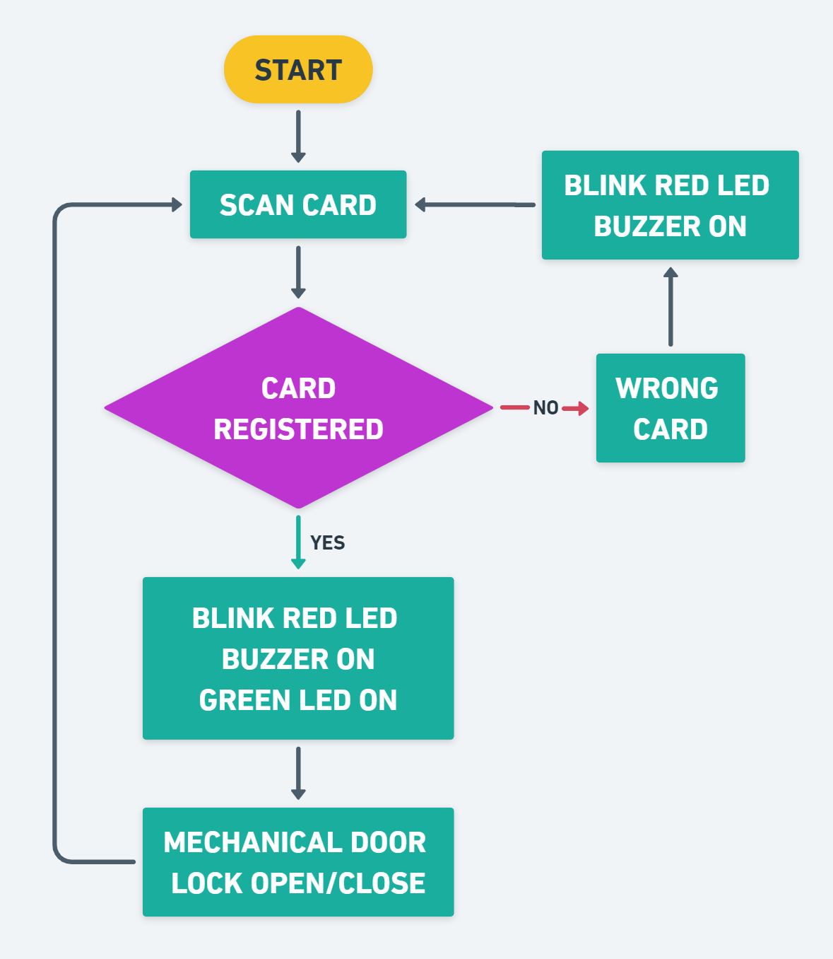
Methodology
Go, change the world
RV College of Engineering
The door lock system will start, and the scanning process occurs, if the card is registered previously then the command will proceed otherwise the WRONG CARD message appeared with the Red LED blinks and buzzer beeps and again the command scanning process will start, If the card is registered, the Red LED will be blink once buzzer beeps and green led is on and the command will execute into the mechanical door lock system and the door lock will be open. When the door lock is open, the command will run again and the scanning process starts, but now the door lock will be closed.

Slide 11




Web Dev Tools
RV College of Engineering
Go, change the world
What is NEXT JS?
NextJS is a React Framework that is developed by Vercel. It allows programmers to build modern web applications with ease.
Why NEXT JS?
NextJS involves Server Side Rendering. This feature improves the SEO and reduces initial load time. Static Site Generation is another feature which helps in pre-rendering of pages during build.
NextJS automatically splits the code and hence render JavaScript necessary for each page thereby reducing the load on server.
File Based Routing is one remarkable addition in NextJS as compared to React. This also gives support to fast refresh.
Image optimization is also taken care of by NextJS.

Slide 12
Web Dev Tools
RV College of Engineering
Go, change the world
What is TAILWIND CSS?
Tailwind CSS is a CSS Framework which provides classes which can be directly added to HTML elements. The styles are already defined.
Why TAILWIND CSS?
Utility First Approach of Tailwind makes it one of the most used and fastest styling tool. The use of utility classes makes development extremely easy and quick.
It is highly customisable and offers Responsive Design which helps us build websites which are compatible on all kinds of devices and screen sizes.

Slide 13
Other Tools
RV College of Engineering
Go, change the world
We have also made used of the Arduino IDE in order to write the code and interface the Arduino.
We have made use of RFID technology in our model to make sure that the cupboard unlocks only when the smart card is tapped on it.
We have made use of Cirkit Designer to create a sketch of the Circuit Diagram highlighting all the wiring details.

Slide 14
RV College of Engineering
Go, change the world
RESULTS AND DISCUSSION

Slide 15
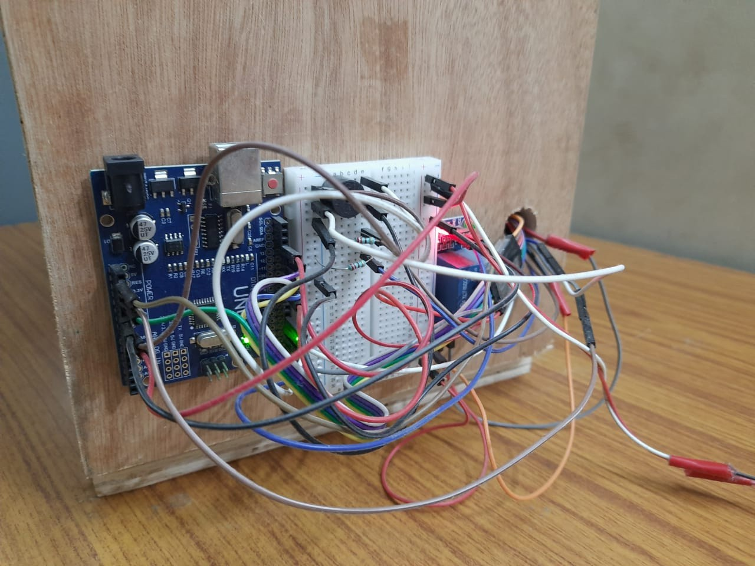
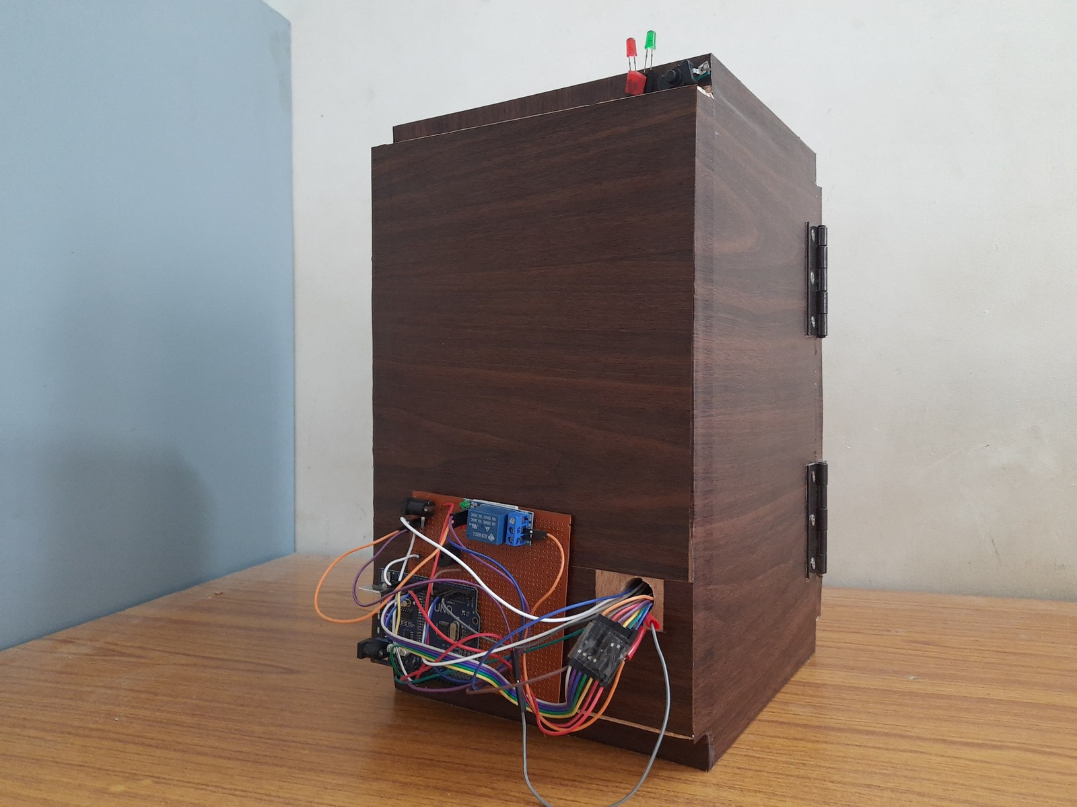
PERF BOARD INCLUSION
Go, change the world
RV College of Engineering
To make the circuit simpler and stable, a perforated board which is a type of PCB has been implemented instead of breadboard. This adds longevity to the circuit and makes it robust. The board has pre-drilled holes for connections.

Slide 16
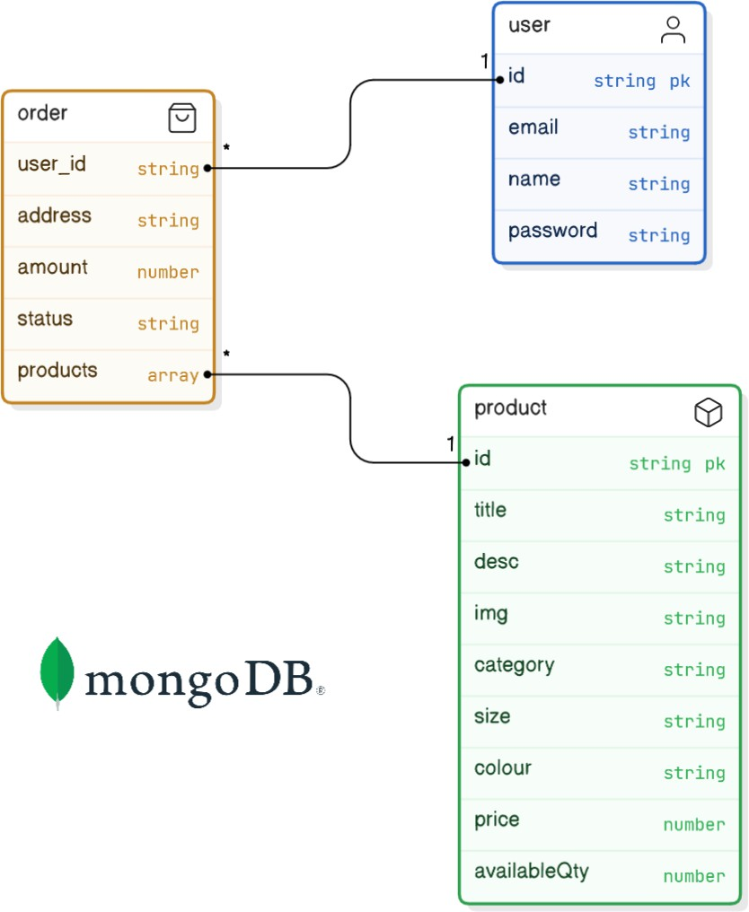
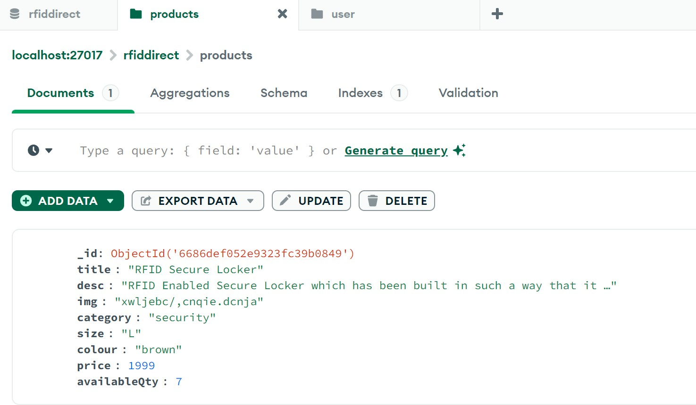
DATA MODELLING
Go, change the world
RV College of Engineering
Data modelling done via mongoose and database used is MongoDB - NoSQL database.
Offers more flexibility to the developer and stores data in form of objects defined in the schema.

Slide 17
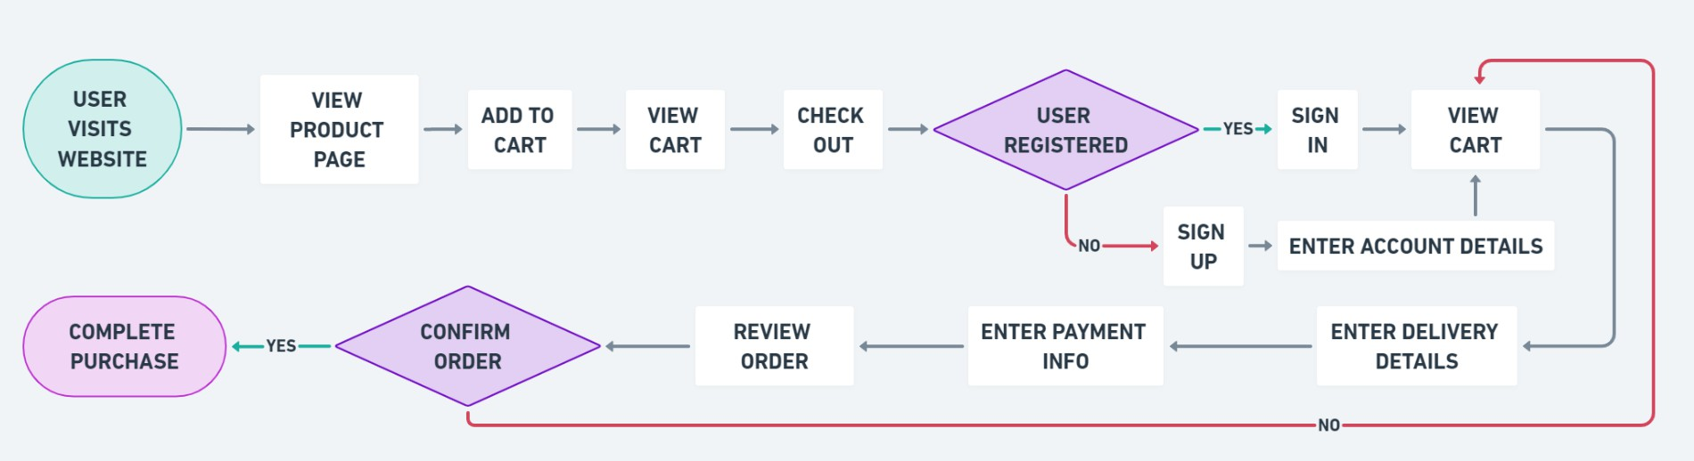
CHECK OUT
RV College of Engineering
Go, change the world
The website offers a smooth checkout process. The payment integration has been done using Razor Pay which automatically collects the payments and sends the receipts to customer and order/shipping details to the admin.

Slide 18
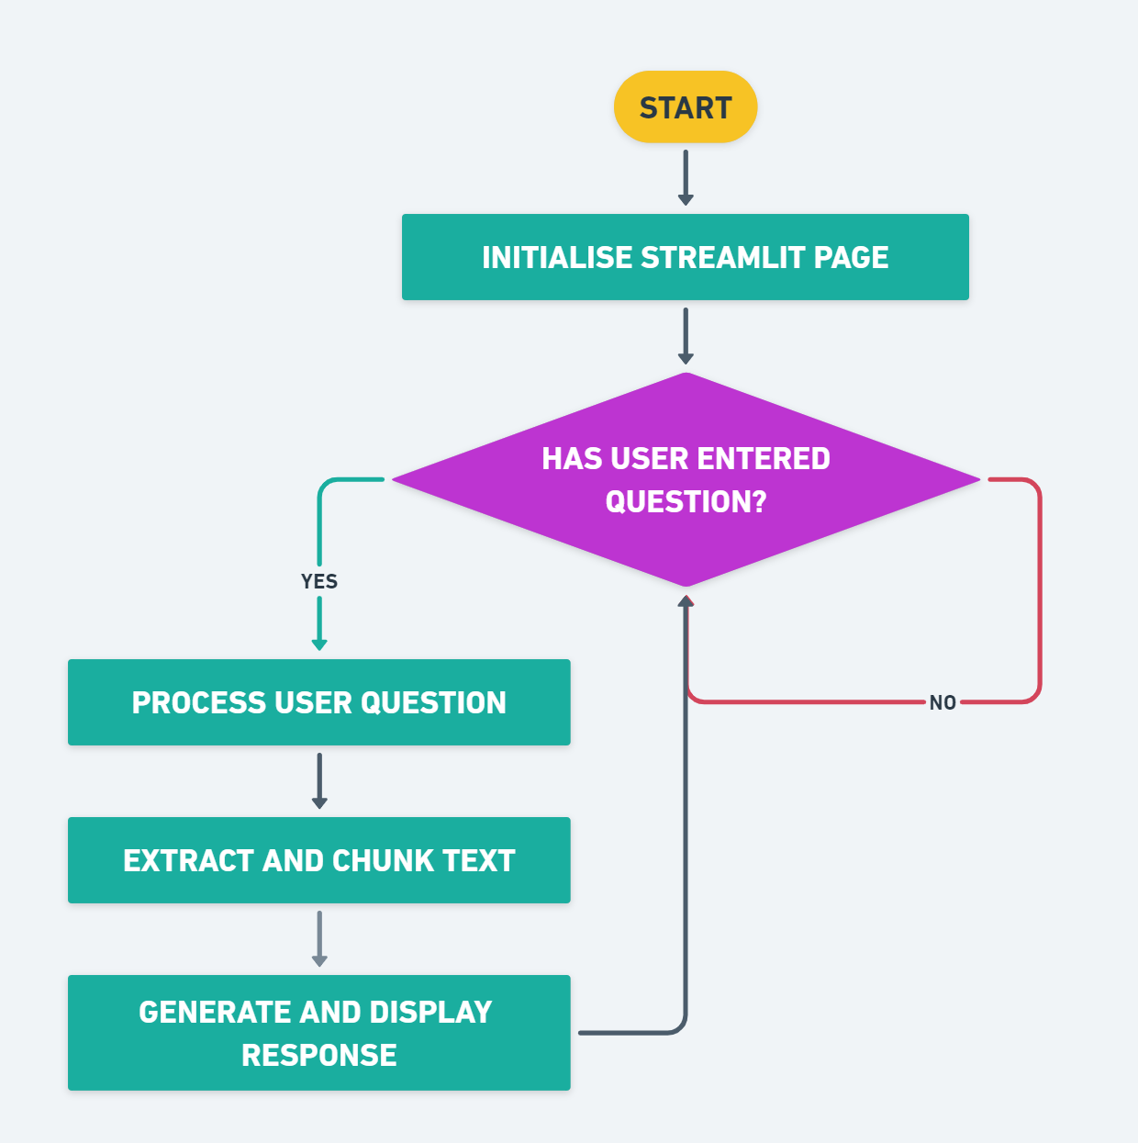
CUSTOM CHATBOT
Go, change the world
RV College of Engineering
This chatbot has been created using the Gemini API.
A Streamlit web application has been created which extracts the text, and stores it in a FAISS vector store using Langchain and Google Generative AI embeddings. Users can input questions, which are answered by searching the vector store for relevant information and generating a detailed response using a conversational AI model. The process involves reading PDFs, splitting text, generating embeddings, and handling user queries in real-time.

Slide 19

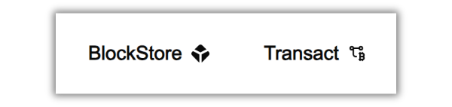
Blockchain Technology
Go, change the world
RV College of Engineering
Arweave, a decentralized storage solution, utilizes a novel consensus mechanism called "Proof of Access" (PoA) for mining, which ensures permanent data storage on its decentralized network. Miners are rewarded with AR tokens for storing and retrieving data efficiently. Unlike traditional blockchain mining, Arweave miners must provide proof that they can access previously stored data, promoting long-term data availability.
Arweave's network ensures data immutability and redundancy by distributing pieces of data across numerous nodes. This approach offers a reliable and cost-effective solution for permanent data storage, making Arweave an attractive option for developers and users seeking long-term data preservation.
Hence we use Arweave to provide our customers with free and secure virtual storage.

Slide 20
Blockchain Technology
Go, change the world
RV College of Engineering

Slide 21

Blockchain Technology
RV College of Engineering
Go, change the world
Proof of Authority
Proof of Work

Slide 22

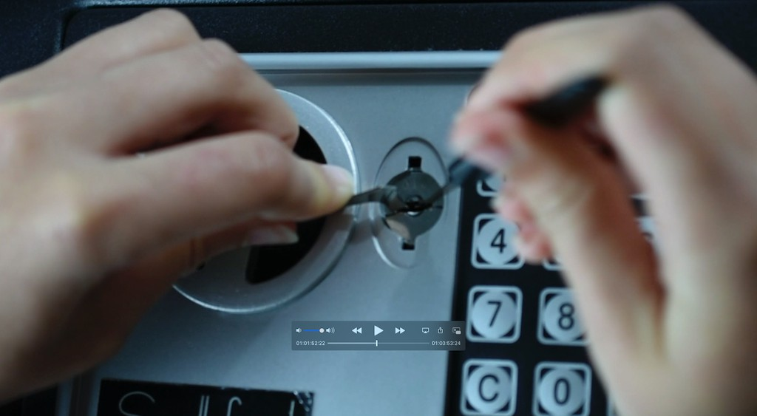
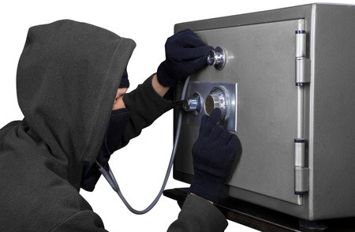
Worth the money? YES
Go, change the world
RV College of Engineering
A SetScope is a locksmith tool for non-destructively decoding safe combinations by visually observing the internal lock mechanism.
To open locks with lock picks, manipulate pins using picks and a tension wrench to align all pins and unlock.

Slide 23
Objectives
Go, change the world
RV College of Engineering
The objectives behind making the secure locker was -
Understand how RFID works and how it’s used in real life, like tracking and access control. - YES
Design a secure storage system using RFID and Arduino to ensure only authorized access. - YES
Develop a web app to market and sell your product, ensuring it can handle growing user numbers. - YES
Learn about blockchain and design a plan to use it for secure and reliable storage. -
YES

Slide 24
Application and Real Time Relevance
Go, change the world
RV College of Engineering
This secure locker can be used in various places such as offices, banks, businesses, and even in homes to ensure the safety of valuable items.
The e-commerce website helps in selling this secure locker, making it easy for customers to learn about and purchase the product online.
The blockchain plan will ensure that the delivery process is safe and transparent, providing peace of mind to customers that their purchase will arrive securely.
The locker’s RFID technology ensures that only authorized individuals can access the contents, enhancing security and preventing unauthorized access.
The web app can also offer support and updates for the locker, allowing users to manage their locker settings and receive firmware updates to keep their device secure and up to date.

Slide 25
Conclusion
Go, change the world
RV College of Engineering
Our team embarked on an enlightening journey that deepened our understanding of RFID technology, Arduino interfacing, blockchain technology, and web development. Through collaboration on this project, we discovered the critical importance of effective communication, teamwork, and adaptability in overcoming challenges. The hands-on experience significantly enhanced our problem-solving abilities and solidified our grasp of fundamental techniques. This journey not only broadened our technical skills but also strengthened our capacity to work together efficiently and innovate effectively.
We would like to express our sincere gratitude to our esteemed Principal and Deans for their continuous support. We extend special thanks to the Heads of Departments, faculty members, and all our mentors for their invaluable guidance throughout our experiential learning journey. Their insights and support have been crucial to our success.

